Slide 1


HOSPITAL MANAGEMENT SYSTEM
Team-
Jivan JAMdar
HitendrA KUMAR Dewangan
Raj Agrawal
balkrishna

Slide 2
Overview
The Hospital Management System (HMS) is a software solution designed to manage patient records, appointments, and emergency handling efficiently. This system utilizes an AVL Tree for maintaining patient records, ensuring that the data remains balanced and retrieval operations are performed quickly. Additionally, Queue and Stack data structures are used for managing patient appointments and emergency cases, respectively.

Slide 3
Features of the Hospital Management System (HMS)
Patient Management:
Registration: Adding new patients to the system.
Check-in/Check-out: Recording patient arrival and departure.
Appointment Scheduling: Booking appointments with doctors.
Emergency Handling: Prioritizing emergency cases.
Search: Finding patients by ID.
Listing Patients: Viewing all registered patients.

Slide 4
Three primary data structures the Hospital Management System (HMS)
AVL Tree - Used to store and manage patient records efficiently.
Stack - Used to manage emergency cases in a last-in-first-out (LIFO) order.
Queue - Used to manage patient appointments in a first-in-first-out (FIFO) order.

Slide 5
The TreeNode class is a helper class for the AVL Tree. It represents a node in the AVL tree containing a patient and pointers to its left and right children.
patient: A Patient object stored in the node.
left: Reference to the left child node.
right: Reference to the right child node.
height: Height of the node in the AVL tree (used for balancing).

Slide 6
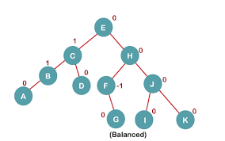
AVL Tree
A self-balancing binary search tree that ensures O(log n) time complexity for insertion, deletion, and search operations. This is crucial for efficient management and retrieval of patient records.
Root node of avl tree

Slide 7
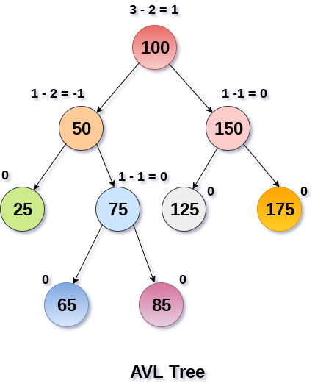
AVL Tree
Operations performed :
1. insert(root, patient): Inserts a new patient into the AVL tree, maintaining its balance.
2. delete(root, patient_id): Deletes a patient from the AVL tree, maintaining its balance.
3. left_rotate(z): Performs a left rotation around node z.
4. right_rotate(z): Performs a right rotation around node z.
5. get_height(root): Returns the height of a node.
6. get_balance(root): Computes the balance factor of a node.
7. get_min_value_node(root): Finds the node with the minimum patient_id in the subtree rooted at root.
8. search(root, patient_id): Searches for a patient in the AVL tree by patient_id.

Slide 8
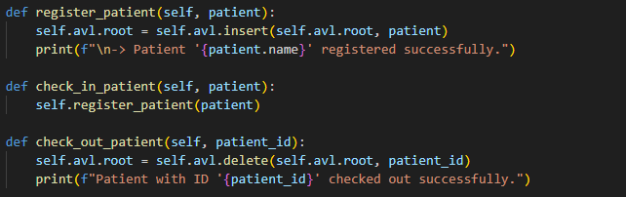
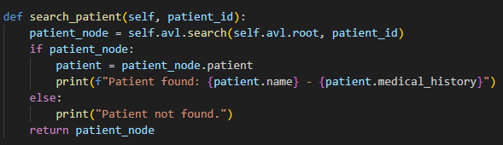
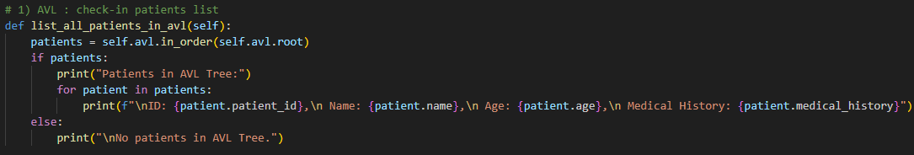
AVL Tree
HMS
insert()
O(log n)
insert()
O(log n)
Delete()
O(log n)
search()
O(log n)
Sorted listing
O(n)

Slide 9

STACK
Used to manage emergency cases in a last-in-first-out (LIFO) order.
Ensures that the most recent emergency cases are prioritized for treatment.

Slide 10
STACK
Operations:
is_empty(): Checks if the stack is empty.
push(item): Adds an item to the top of the stack.
pop(): Removes and returns the item from the top of the stack.
peek(): Returns the item at the top of the stack without removing it.

Slide 11
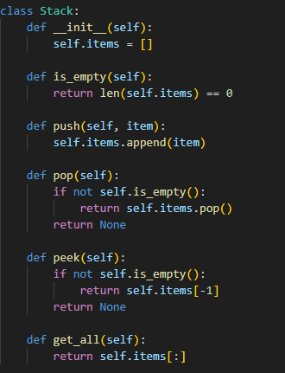

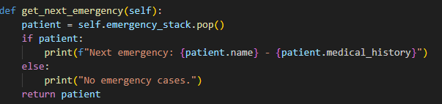
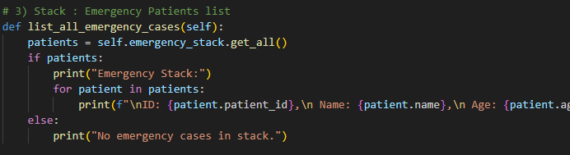
STACK
O(1)
O(1)
O(1)
O(1)
O(n)

Slide 12
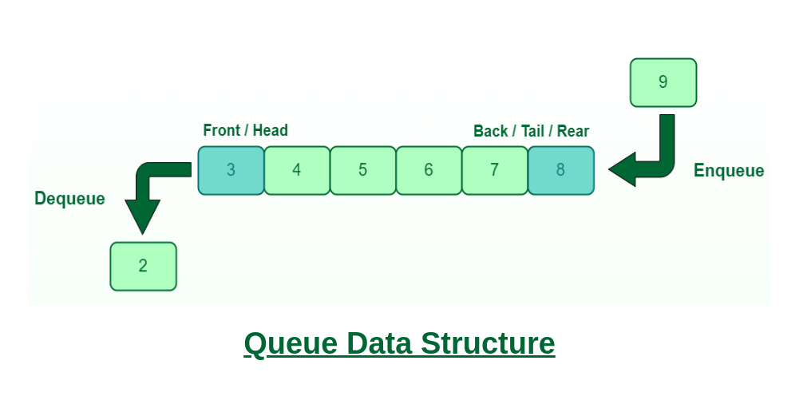
QUEUE
Ensures that patients are seen in the order they arrived for their appointments.
Used to manage patient appointments in a first-in-first-out (FIFO) order.

Slide 13
QUEUE
Operations:
is_empty(): Checks if the queue is empty.
enqueue(item): Adds an item to the end of the queue.
dequeue(): Removes and returns the item from the front of the queue.
peek(): Returns the item at the front of the queue without removing it.

Slide 14
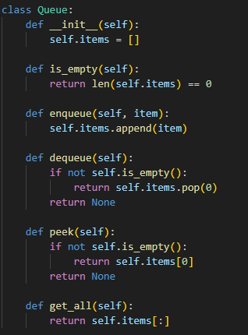

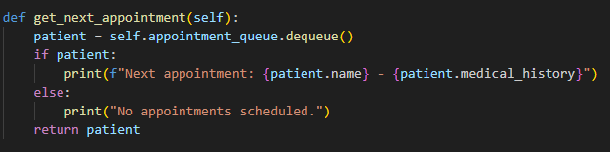
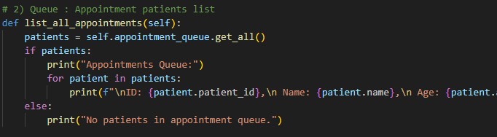
QUEUE
O(1)
O(1)
O(1)
O(1)
O(n)

Slide 15
Instance scenerio

Slide 16
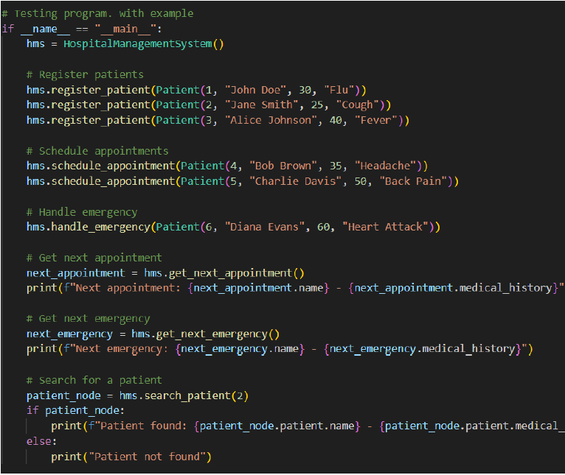
Instance

Slide 17
ADDITIONAL FEATURS IN FUTURE

Slide 18
ADDITIONAL FEATURS IN FUTURE
Medication Management:
Linked Lists: Store medication prescriptions and refill information in a chronological order.
Hash Tables: Quickly access medication information based on the medication name or ID.
Inventory Management:
Trees: Organize inventory items in a hierarchical structure based on categories or types.
Hash Tables: Quickly search for items based on their unique identifiers.
Bed Management:
Graphs: Model the relationships between beds, patients, and wards.
Priority Queues: Prioritize beds based on patient needs or urgency.

Slide 19

DOUBTS ?

Slide 20
THANK YOU

